Slide 1
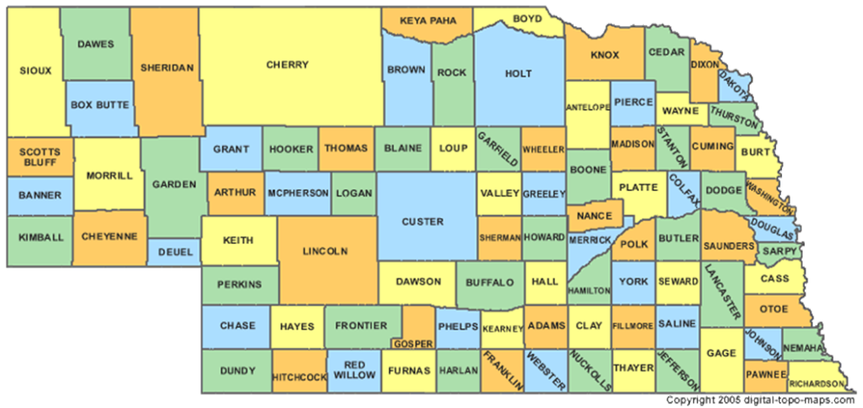
No more living someone else’s dream
Irene Britt, MA Ed , Executive Director
irnebraska.org

Slide 2
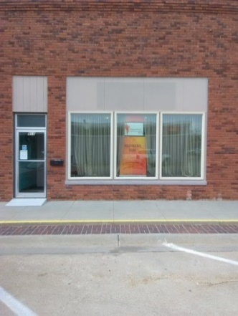
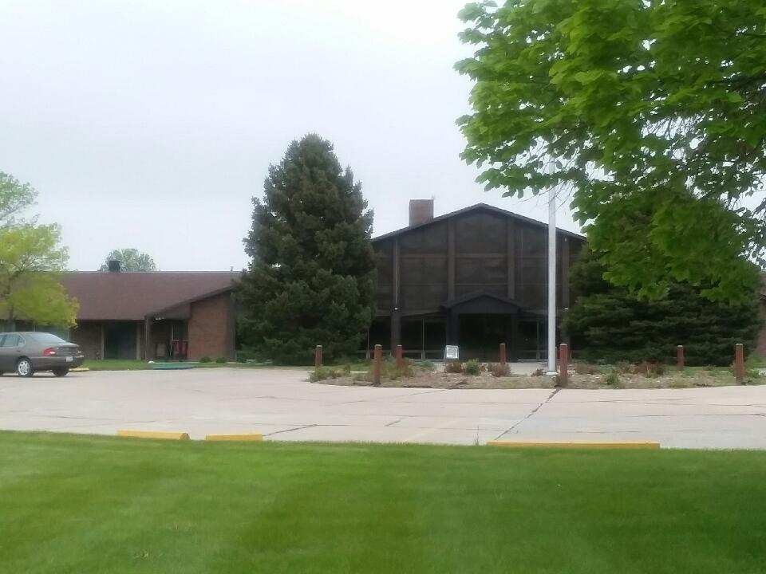
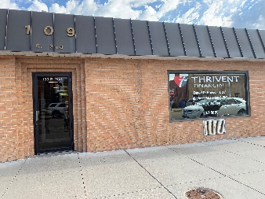
Independence Rising Offices Grand Island Gothenburg Gering 3335 West Capital 910 Avenue F 2350 Five Rocks Road
Kearney
St. James Square
124 W 24th St. Suite B
North Platte
109 East 2nd St. Suite 3

Slide 3
Independence Rising
Independence Rising, IR, was formerly known as Center for Independent Living of Central Nebraska.
IR services 50 counties in Central and Western Nebraska.
IR is one of two federally funded independent living centers in Nebraska along with The League.
IR offers services free of charge (grant funded) and fee for service.
IR works with consumers to help them achieve their chosen, community-based living goals.
Consumers of the agency have a self-disclosed, disabling condition that makes them eligible to receive agency assistance with facilitating their self-chosen community based living goals.
IR serves persons with disabilities across the age span with any type of disabling condition.

Slide 4
Independence Rising (IR), serves fifty counties in Nebraska (Assigned Counties left of boundary line) (federally funded services)

Slide 5
Vision Statement
The following statement expresses our vision of a future that can be achieved and to which we commit ourselves and our resources. "Nebraskans with disabilities are valued within their communities, have control over their own lives, and have available the resources necessary to experience a life of quality."

Slide 6
Mission Statement
"Our mission is to provide a comprehensive set of services designed to enable persons with disabilities to exercise control over their lives based on their choices of acceptable options that minimize their reliance on other people in making decisions and in performing everyday activities. This includes: managing their affairs, fulfilling the range of social roles, making decisions that lead to self-determination, and minimizing their physical and psychological dependence on others. Our Center stresses that independence is not a matter of ability or limitation, but is instead a matter of making educated choices.

Slide 7
Independence Rising Program Service Array
Independence Rising has three types of services on the current service array of programs offered through the agency. These program categories are:
Independent Living Program Services
Statewide Fee for Service Programs
Regionally offered Fee for Service Programs

Slide 8
IR’s federally funded services
IR services are available for persons with disabilities, services include:
Living Skills Training
Advocacy
Information and Referral
Peer Mentoring and Networking
Transition Services
**These Services are the main focus of the agency and the reason that the agency is in existence. All other services offered through the agency align with and implement the independent living philosophy.

Slide 9
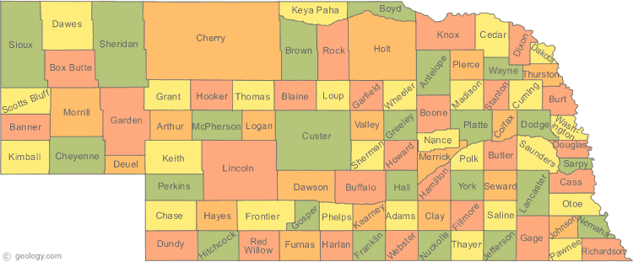
IR also provides the following fee for service programs statewide:
Driving Program Services
DHHS Family Support Program Services *(DHHS service areas)
“Back On Track” Youth Probation Family Support Services
Independence at Home Caregiver Services
Equipment Rental Loan Program

Slide 10
Regional Program Service Array
Independence Rising offers the following programs at specific locations in the 50 county agency territory:
Current Programs:
ARC Census Fingerprinting Program
Peer Link
Consumer Mentoring
Family First Partnership Contract
Respite Across the Lifespan
Institutional Transitions*
Upcoming Programs:
Transitional Living Program**
Family Org
Peer Run Organization
*Indicates services funded through federal grant
**Potential to serve consumers statewide..

Slide 11
Federally Funded Services Living Skills Training
IR offers individualized independent living skills training in the following areas:
Budgeting
Financial Management
Grocery Shopping
Homemaking
Locating Housing
Cooking
Personal Assistant Management
And any other goal areas identified by the consumer

Slide 12
Federally Funded Services Advocacy
IR supports Individual, self, and systems advocacy for persons with disabilities.
Individual advocacy is an action on behalf of, for, and most importantly with an individual, which may include confronting unacceptable conditions that infringe upon daily living.
Self-advocacy addresses specific issues in one’s own life by advocating on one’s own behalf like filing a complaint or talking to local government to get sidewalks installed in your neighborhood
Systems advocacy is working to create change within a system, agency or jurisdiction. This can include speaking out on policy, laws and practices that affect people with disabilities.

Slide 13
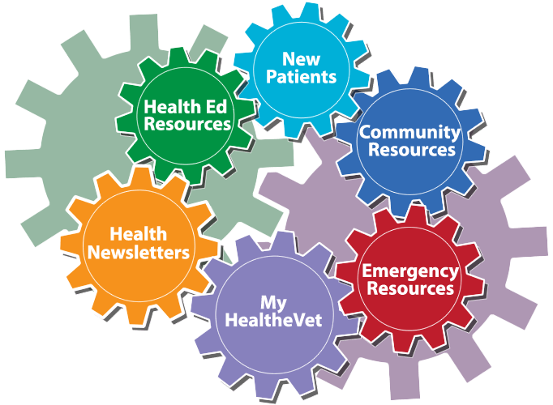
Federally Funded Services Information and Referral
IR Provides:
Information on community resources
Referrals to other agencies
Intensive assistance for agency consumers
Services are available to anyone

Slide 14
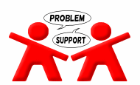
Federally Funded Services Peer Mentoring and Networking
IR recognizes that persons with disabilities need to work through the emotions brought on by acquiring or having a disability.
It is our belief that the most appropriate person to assist with this process is another person with a disability.
This sharing of life experiences empowers the individual to live as independently as they choose.
IR offers:
One to One Peer Connection

Slide 15
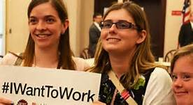
Federally Funded Services Transitions Services
The fifth core service came about as a result of the Workforce Innovation and Opportunity Act. This amendment was made to establish the fifth core service of transition.
There are different types of transition services offered through independent living. The following information explains the services:
Reintegration
Transition from living in an institutional setting to independent living in a community based setting.
Youth Transition
Transition from high school to work or continued education.

Slide 16
Fee For Service Programs Statewide Independence At Home
Independence at Home, IAH, is a chore agency that provides services to individuals to assist them with living independently. Services include:
Assistance with light housekeeping
Supervision
Personal care
Errands
Meal Preparation
**Private pay and Waiver payments accepted

Slide 17
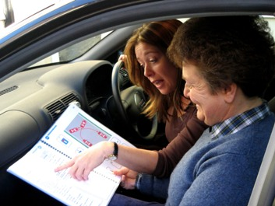
Fee For Service Programs Statewide Driving Program Services
Independence Rising offers the following services for agency consumers as well as individuals that have a goal of obtaining a driver’s license. IR also has a car that is accessible for persons with physical disabilities. In order to receive the following services all individuals need to have a valid learner’ permit.
Driving Evaluations (written and driving)
Driving Lessons

Slide 18
Fee For Service Programs Statewide Family Support Services
IR has a contract with Department of Health and Human Services, (DHHS), to provide services to families working with child protective services. Services include:
Family Support Services
Supervision at Parent/Child Visitations
Drug Testing
Parent Education

Slide 19
Fee For Service Programs Statewide “Back On Track” Youth Probation Services
Independence Rising holds a contract with Nebraska Probation to provide family support services to youth that are going through probation services.
Through this contract, Independence Rising works alongside youth to help facilitate work on goals to complete court ordered probation successfully.
Additionally, Independence Rising is committed to helping assure youth with mental and cognitive disabilities receive intervening services and advocacy efforts in order to avoid involvement in the court system. Recently, Independence Rising helped to co-host a series of meetings in the North Platte area called “Classroom to Courtroom” in which the ultimate goal is to bring a group of agencies and individuals together to help educate the community on the over representation of youth with disabilities in the criminal justice system, as well as to help provide a framework of options for youth and their families to have options of interventions before involvement in the court system.

Slide 20
Fee For Service Programs Statewide Home Again Services
IR is a contracted provider for Home Again Services.
In order to receive home again services, consumers need to be eligible for the Aged and Disabled Medicaid Waiver.
Home Again services provide consumers that are transitioning from institutions to community based living with funding to reestablish their household.
Examples of items include: furnishings, dishes, sheets, towels, beds, dressers, etc. In some instances, deposits such as electric and gas can be funded.

Slide 21
Fee for Service Programs Statewide Equipment Rental Program
Assistive Technology
Assistive technology devices are items or pieces of equipment that are used to increase, maintain, or improve functional capabilities of individuals with disabilities. IR offers an equipment rental program that loans equipment such as wheelchairs and walkers to individuals.
Equipment Rental
Demonstration of equipment usage
Long-term equipment rental services when needed

Slide 22
Fee for Service Programs Regionally Offered ARC Census Project
Independence Rising has contracted with the ARC in Washington DC to provide fingerprinting services for potential employees applying as workers for the 2020 census.
Independence Rising is providing fingerprint services eight hours per week from May-December 2019 and then services will increase to six days a week for the full year 2020.
The agency is working with Vocational Rehabilitation as well as publically advertising for the fingerprint operator positions in order to recruit persons with disabilities to work in the positions.
**Program available only in North Platte.

Slide 23
Fee for Service Programs Regionally Offered Peer Link (Gering office only)
Peer Link is a program through Independence Rising offered in Kimball and Scottsbluff counties.
Peer Link is a program that provides peer services to individuals with mental and/or behavioral health diagnosis’s.
Program staff that work in the program are also individuals with mental/behavioral health issues. Staff receives intensive training to become certified peer specialists.
Funding for Peer Link Program consumers is through Medicaid or Region 1 Behavioral Health.

Slide 24
Fee for Service Programs Regionally Offered Consumer Mentoring
Independence Rising contracts with Region 2 Behavioral Health services to provide voluntary family support services to families served by the Region 2. The agency provides support and advocacy services for families experiencing mental health issues in order for them to work towards their self-chosen goals to deal with these issues.
Independence Rising also contracts to provide mentoring services for transition-aged youth served by Region 2. Mentoring includes IR staff working with youth on the consumer’s self-chosen mentoring goals. These can include activities such as going into the community to develop inclusive hobbies and activities, help working on homework, spending time on chosen activities and hobbies initiated by the youth, as well as any other identified, consumer driven goals.

Slide 25
Fee for Service Programs Regionally Offered Families First Partnership Contracted Services
Independence Rising is a Community Response Partner with Families First Partnership. This is a reimbursement program in which Independence Rising is able to purchases items and services families need to live in the community as then be reimbursed for the purchases. An example would be car tires for a family to be able to get to school and doctor’s appointments. This service is only available in Lincoln County. Independence Rising is also a family coach through the partnership in which IR staff works with families with community based living goals. Families are at risk of not be able to function independently in the community. The Partnership also has extra funding to provide services for families with children with severe mental/behavioral health needs as well as parenting teen parents that were involved in the foster care system as youth. Independence Rising also offers coaching to families through this partnership. Available in Lincoln County only.

Slide 26
Program Services Offered throughout Territory Grant Funded Institutional Transitions
Independence Rising is in the initial stages of implementing transition services for persons with disabilities that are currently incarcerated. In the Gering/Scottsbluff area, served through the Independence Rising Gering office, a weekly classes are being offered to inmates in the detention center in Scottsbluff. Individual work with inmates to help with information and referral as well as assistance with transition planning from institutional living to community based living. Independence Rising is also in the process of connecting with the detention centers in Lincoln and Dawson Counties to investigate the possibility of offering group and individual programs and services for assistance for inmates from institutional to community based living. Long term vision for this program is to serve detention centers throughout the fifty county territory.

Slide 27
Fee for Service Programs Upcoming Respite Across the Lifespan
Independence Rising began a contract with Respite Across the Lifespan contract for the Grand Island, Kearney, and counties north of this Central area of the State starting October 2019.
Respite Across the Lifespan provides respite services for to eligible family members and informal support of persons with disabilities living in community based living. In these situations, the support system helps to provide supervision and services in order to provide care for the consumer in their homes and community. When the support system needs a break or time off, Respite Across the Lifespan finds approved providers to provide in-home services for these consumers.
These services are available for eligible consumers and their families across the lifespan and cross disability.

Slide 28
Fee for Service Programs Upcoming Transitional Living Program
Independence Rising is mandated to provide services to transition-aged youth, teens to young adults, with disabilities. Additionally, Independence Rising is committed to do provide in depth service provisions to these youth that are also at-risk.
This service provision includes plans for a transitional living facility for youth that are homeless, in crisis within their family unit, and youth with mental health and substance abuse diagnosis’s.
Within this vision, Independence Rising will offer a continuum of independent living skills facilitation to help provide this population of youth the opportunity to transition to adulthood and live independently in the community. This includes working towards self-determined goals such as: finding housing, accessing mental health services, applying for jobs, applying for disability, finding connections within the community for inclusion, and access to mentoring as well as any other goal identified by the consumer and/or their families as appropriate.
Location is tentatively slated for Dawson and Lincoln Counties.

Slide 29
Fee for Service Programs Upcoming Family Link Peer Services
Independence Rising is participating in a mentoring partnership with Families Care in order to assume duties for the Family Org in Region 2 and Region 1 Behavioral Health Regions beginning January 2020.
Family Orgs provide peer support for parents and families of children with severe mental and/or behavioral health diagnosis’s.
These services are provided in the community and services are voluntary.
Staff that work within the program are Certified Peer Support Specialist.

Slide 30
Fee for Service Programs Upcoming Peer Run Organization
Independence Rising is partnering with specific community agencies in order to develop peer programs for populations of consumers served by the agency. Although the program is very early in development, the initial goal is to have peers that are certified peer specialists have the opportunity to work with persons that have experienced similar disabling conditions, in the area of mental and behavioral health, and are working to set goals for community living.
The program services will require payment sources through Medicaid and other possible payment sources.

Slide 31
Consumer Story (Advocacy)
DT’s Life Experience
DT started working with Center for Independent Living, CIL, when he became eligible for the A & D Medicaid Waiver program in 2001. He had moved back to the community he grew up in Southwest Nebraska after being diagnosed with an aggressive form of multiple sclerosis, MS, in his 30’s. The disease progressed rapidly and resulted in DT’s need for a wheelchair for mobility as well as intense pain in his back. Upon diagnosis, DT had lived in Montana and had owned and operated his own restaurant. He also had a well-developed hobby of collecting tropical fish, and according to his own report, he had a wall of his home covered in fish aquariums with many fish of all shapes and sizes. DT’s life changed dramatically in a short period of time with the onset of his disability. Prior to moving back to Nebraska, he required assistance with mobility and could no longer get in or out of bed. His long term girlfriend deserted him one day in the home they shared, and upon trying to transfer in and out of bed, he became wedged between his bed and the wall for 18 hours. He provided a new name for his former girlfriend after that time “the black widow”.
CIL provided services coordination and resource development services for DT from 2001-mid 2010. DT was always an upbeat person even in the face of a life that had changed so dramatically and as well as his experience of living in near constant pain. He commonly joked about meeting that “red headed nurse” he could ask out on a date on one of his frequent medical appointments.
In 2012, DT called his former IR services coordinator after he received a notice that he would no longer receive Waiver services as it had been determined that “a safe plan of services and supports couldn’t be developed and maintained”. DT required assistance with all ADL’s and if he had been taken off of the Waiver program, his only alternative would have been to move into a long term care facility due to his level of care.

Slide 32
Consumer Stories (cont’d)
By this time CIL had become Independence Rising, IR, and a service of the independent living center was to provide advocacy services to persons with disabilities in community-based living. IR helped DT complete the paperwork to appeal the decision and this included helping DT become familiar with the rules and regulations of the program as well as participating in an appeal hearing held over the phone. The threat of DT’s entire way of life being dramatically changed due to loss of program eligibility and this took a toll on his mental and physical health. He reported to IR staff that when he received the Notice of Action, that was the first time he had not been able to sleep since he was trapped between the bed and wall before he moved back to his hometown.
DT was able to state his needs and opinion during the appeal, he had a chance to be heard and to tell the hearing officer how his life would change if he were taken off the Waiver program. His voice was shaky and he was furious as well as physically shaking, but he did it! DT was exhausted after the hearing and it took some time for him to recover.
Several weeks after the hearing occurred, IR Staff received a voice message from DT and his provider. On the message DT was cheering and “whooping” in the background, his provider had explained he had won the appeal! DT also said in the message he wanted to celebrate with the IR Staff as his way of life had been saved and he could live independently where and how he chose to live. This victory was life changing for DT as he could remain in the same location, house, with the same provider, etc., as he had for over a decade since moving back to his hometown due to the onset of MS.
Sadly, in a short time after he won the appeal, DT was diagnosed with an aggressive form of skin cancer and passed away within weeks. He never was able to celebrate his victory with IR Staff, however he was allowed to remain in his own home and live life on his own terms!

Slide 33
Consumer Stories (cont’d)
As a testament to the way DT viewed the road he traveled after being diagnosed with MS, it is important to share the following life experience he told IR staff when he was trying to find meaning and context with the Waiver determination after he received the Notice of Action. The following is his recounting of his memory:
“I remember when I was first diagnosed with MS and I was laying in bed feeling sorry for myself. The television was on and the volume was down. I saw all these kids running around looking like they were having a great time at a summer camp. They were smiling, swimming, and enjoying the outdoors. I turned up the volume and then I heard that this was a summer camp for kids, but it was a camp for kids that were terminally ill. So these kids were going to die in a short period of time. Right then I decided that I was fortunate that I wasn’t going to die because of MS and if these kids could look on the bright side and enjoy life, then I had nothing to complain about. I quit feeling sorry for myself right then.”

Slide 34
In some ways we are all alike…

Slide 35
Independence Rising Administrative, Supervisory, and Lead Staff
Irene Britt
Executive Director
(308)258-1914, Gothenburg Office Location
ibritt@cline.org
Vicki Anson
Program Manager/DHHS Family Support Supervisor
(308)382-9255/(402)321-5435, Grand Island Office Location
cilnegi.anson@gmail.com
Mary Stockwell
Program Manager/ IL Program Supervisor
(308)641-8449, Gering Office Location
ir.stockwellm@gmail.com
Jamie Meyer
IAH Coordinator
(308)382-9255, Grand Island Office Location
jmeyer@cline.org
Helena Beyer
Programs Quality Coordinator/Human Resources
(308)627-3989, North Platte Office Location
ir.beyerh@gmail.com

